Slide 1
Blood Relation
Reasoning

Slide 2
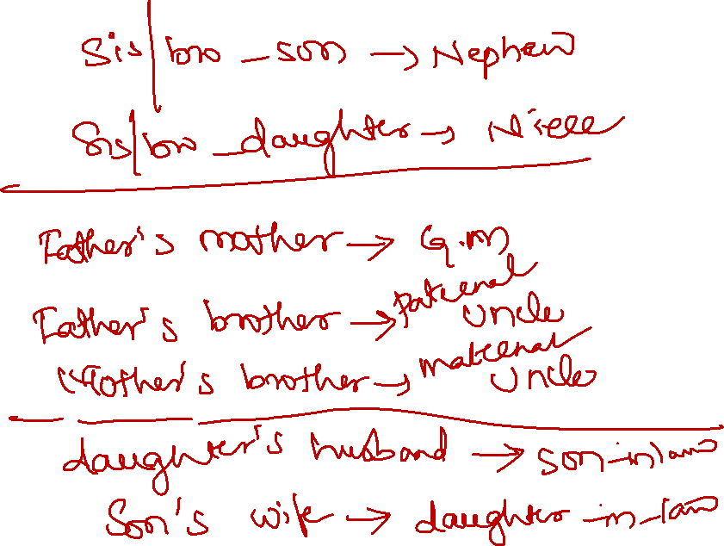

Slide 3
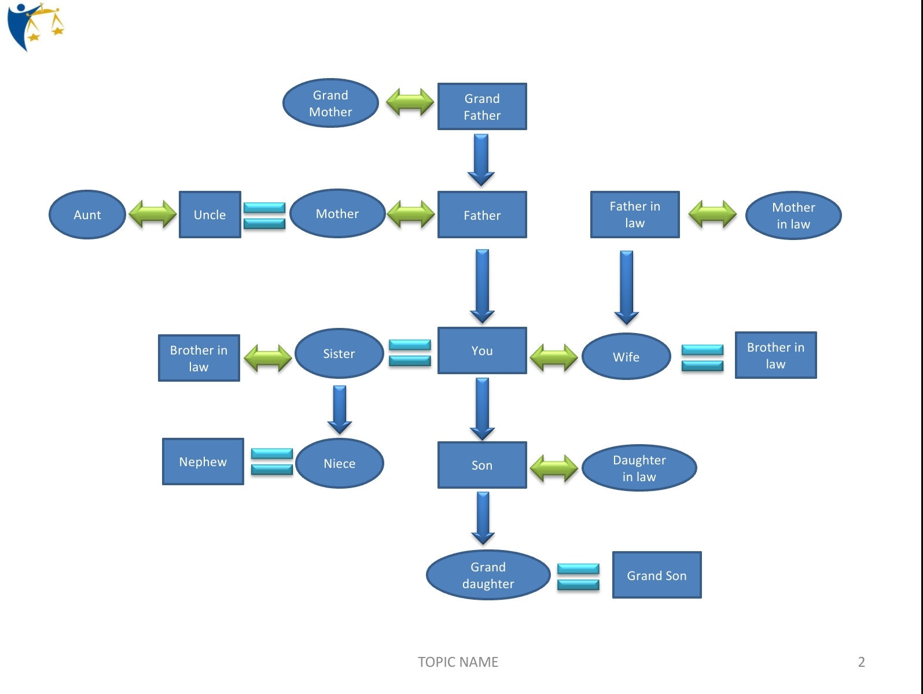


Slide 4
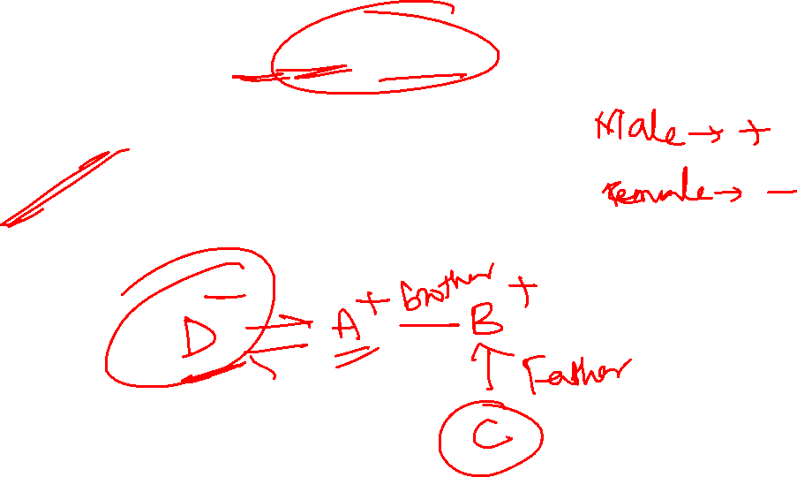
1. A is the brother of B, B is the father of C, D is the wife of A. how is D related to C?
Sister
Aunt
Mother
Mother-in-law

Slide 5

2. P is the brother of Q. R is the daughter of Q. S is the sister of P. Q is sister of S. T is the brother of R. who is the uncle of T?
P
Q
C
S

Slide 6

3. Renu is Sashi’s daughter. Sashi is babli’s mother. Vanish is Babli’s brother. How is vanish related to Renu?
Father
Nephew
Brother
none

Slide 7

4. Amar is the brother of Babul, babul is the sister of krishna. Krishna is the father of Durga who is the only daughter of Krishna. How is Durga related Amar?
Sister
Niece
Mother
wife

Slide 8

5. Introducing Neeta, Anil said, ’she is the wife of my mother’s only son’. How is Neeta related to Anil
Mother
Wife
Sister
Daughter-in-law

Slide 9
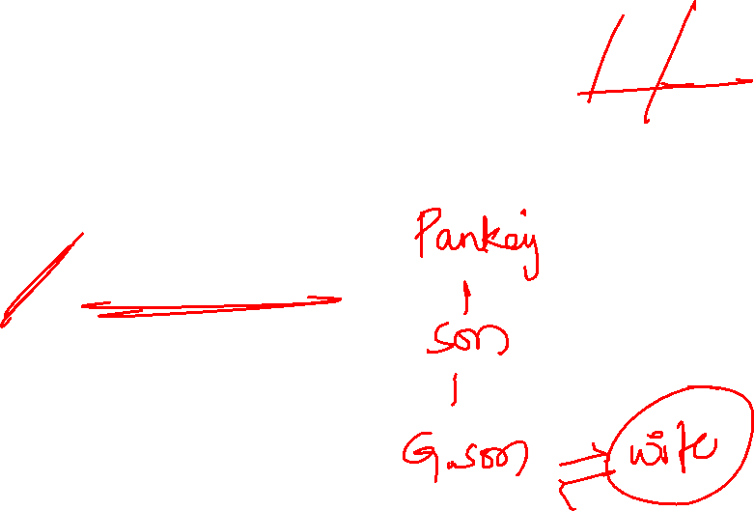
6. Pointing to a girl, Pankaj said “she is the wife of the son of my son”. How is the girl related to Pankaj?
Mother
Wife
Daughter-in-law
Grand Daughter-in-law

Slide 10
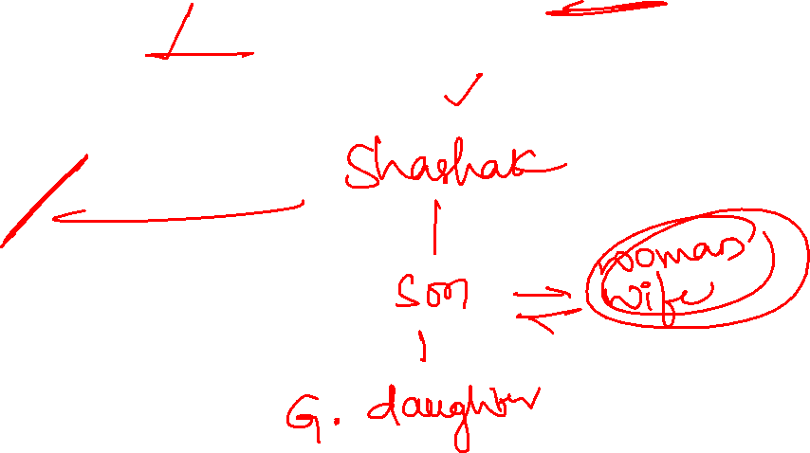
7. Introducing a woman, Shashank said “she is the mother of the only daughter of my son”. How that woman is related to Shashank?
Daughter
Sister-in-law
Wife
Daughter-in-law

Slide 11
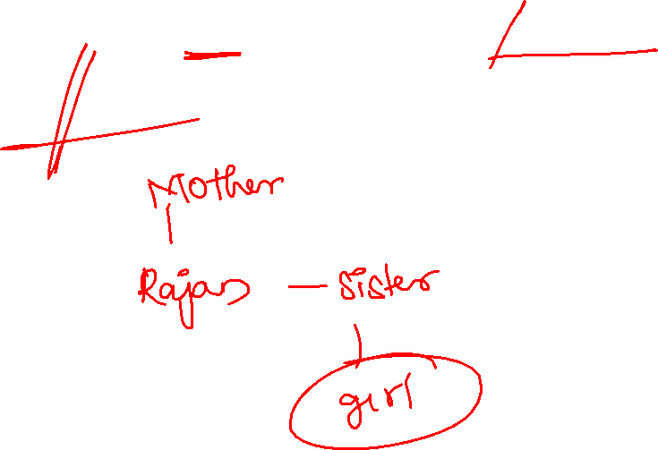
8. Pointing towards a girl, Rajan said, she is the daughter of my Mother’s daughter, then how is the girl related to Rajan?
A) Daughter B) Niece C) Nephew D) Uncle

Slide 12

9. If ram is the husband of Sita and Sita is the daughter in law of Ramu. Rahul is the son of Ram. How Rahul related to Ramu?
A) Grandson
B) Father
C) Grand father
D) Son

Slide 13

10. If Sudha is the daughter of the wife of the only son of the father of Priya’s father, how is Sudha related to Priya if Sudha’s grandfather has no grandson?
A) sister
B) cousin
C) Sister-in-law
D) Mother

Slide 14


11. Arun said, Deepak’s mother is the mother of my father’s wife”. How is Deepak related to Arun?
A) brother
B) Father’s brother
C) Grandfather
D) Maternal uncle

Slide 15
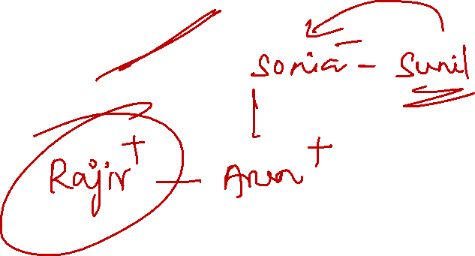
12. Rajiv is the brother of Arun. Sonia is the sister of Sunil. Arun is the son of Sonia. How is Rajiv related to sunil?
A) Son B) Brother C) Father D) Nephew

Slide 16
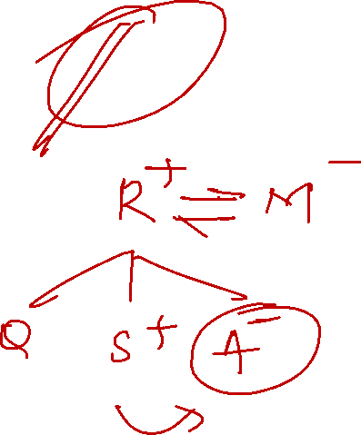
13. S is the son of M. R is the father of Q and A. A is the daughter of M. How is A related to S?
A) Aunt B) Mother C) Daughter D) Sister

Slide 17
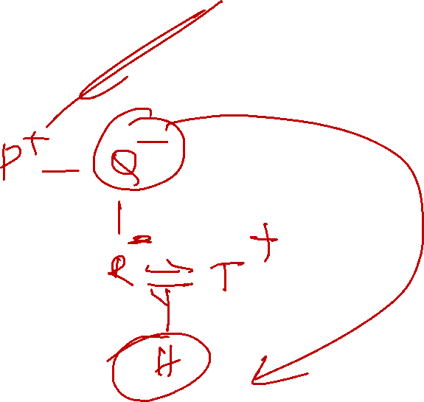
14. P is the brother of Q who is the mother of R. R is married to T who is the father of H. How H related to Q?
A) sister B) Sister-in-law C) mother D) Cannot be determine

Slide 19

1. A # B means A is the brother of B
A @ B means A is the daughter of B
A & B means A is the husband of B
A % B means A is the wife of B if W # Q @ T & Y @ M % K, then how K is related to T?
Mother
Father
Mother-in-law
Father-in-law

Slide 20

2. ‘A & B’ means A is the brother of B
‘A $ B’ means A is the wife of B
‘A @ B’ means A is the son of B if H & D $ K @ T $ L then how is K related to L?
Father
Son-in-law
Son
Brother

Slide 21

3. A * B means A is the sister of B
A @ B means A is the wife of B
A - B means A is the brother of B
A + B means A is the father of B if P + T * U @ V , then how P is related to V?
Uncle
Niece
Father-in-law
Brother
Son-in-law

Slide 22

4. A * B means A is the sister of B
A @ B means A is the wife of B
A - B means A is the brother of B
A + B means A is the father of B if I * J @ K + L - M , then how L is related to I?
Nephew
Husband
Uncle
Father
Mother

Slide 23
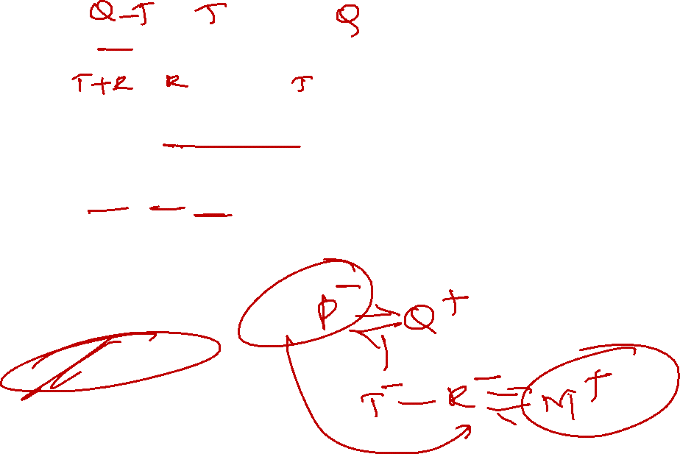
5. A - B means B is the daughter of A
A @ B means A is the son of B
A + B means B is the sister of A
A $ B means A is the wife of B
A * B means A is the father of B if P $ Q – T + R $ M, then how M is related to P?
Son
Daughter
Grandson
Grand daughter
None

Slide 24


